Slide 1
Whale Well
Lan Zhang, Jiaqi Li, Tongkun Xu
Passport Photos of Whale

Slide 2
Menu
Objectives
Data Augmentation
PCB Model
Siamese Network
Future work
Whale Well

Slide 3
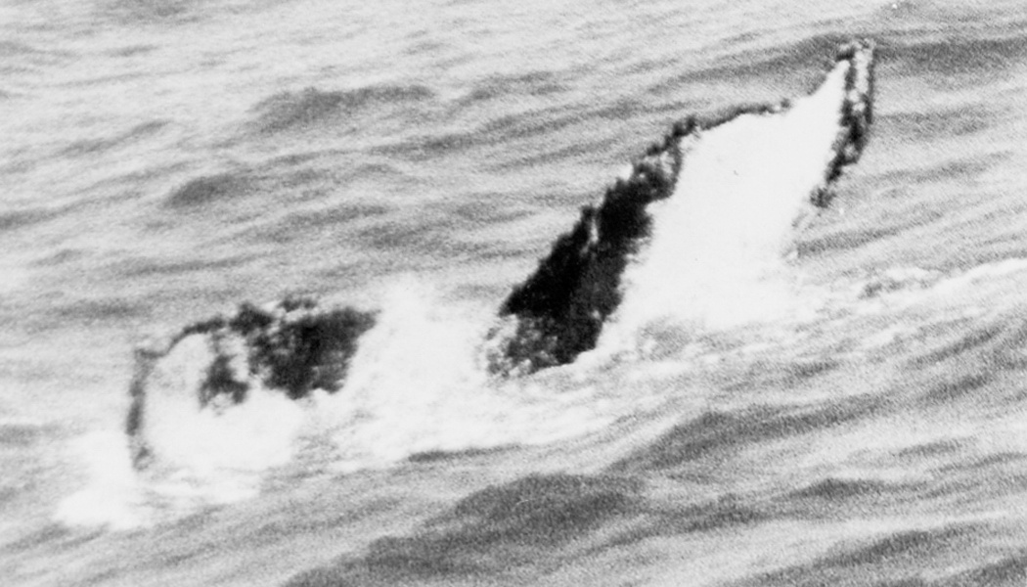
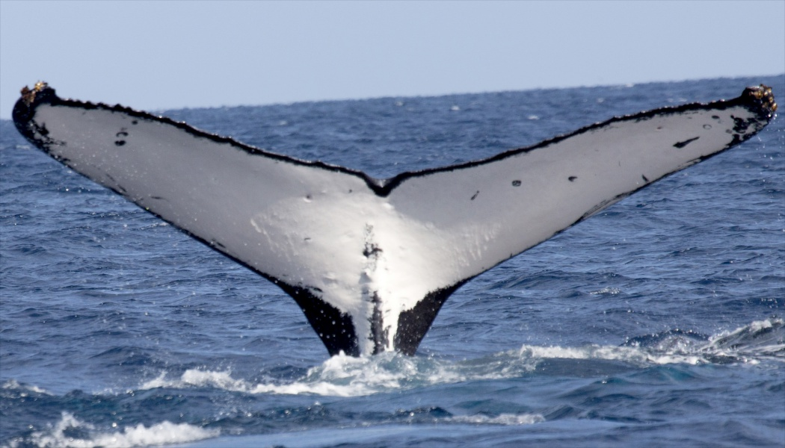
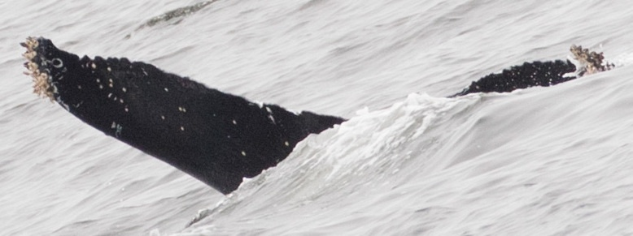
Objectives - Passport Photos of Whale
Classify images of the same species into different individuals
Challenge:
Image Quality: camera equipment, weather, spindrift, View
Hard to find unique characteristics
Whale Well
Notes:
目标：给鲸鱼一张证件照，区分同一个物种的不同个体
图片数据中的挑战，
1.数据质量参差不齐，有些照片拍摄的年代久远，黑白图，甚至是翻拍的书上的图片，
有些照片受环境影响，模糊不清
鲸鱼尾部掀起的浪花遮盖了鲸鱼
拍摄角度多样，完美的像是蝴蝶，不完美的像是鸡翅
2.区分不同种的照片和区分同一个种的个体难度差异很大，我们很容易看到猫和鱼的差异，但通过同一物种尾巴寻找个体难度比较大

Slide 4
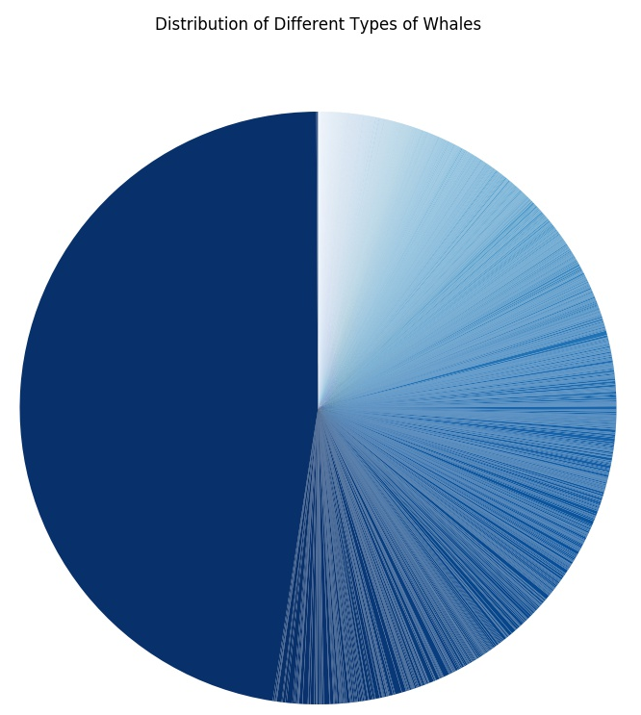
Objectives - Passport Photos of Whale
Dataset distribution：
It was non-straightforward to split the dataset into training and validation set.
One-shot learning
New
Whale
Whale Well
Notes:
数据分布差异很大，未知鲸鱼占到47.5%, 有25.7%的鲸鱼只有1张图片（可以看到白色部分，基本都是一张图片的数据）
这就影响了数据划分的难度，训练集和验证集数据blah blah blah

Slide 5
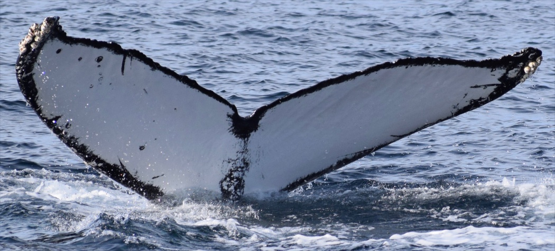
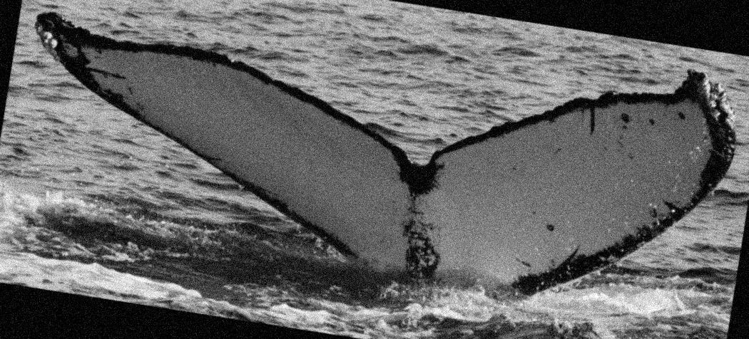
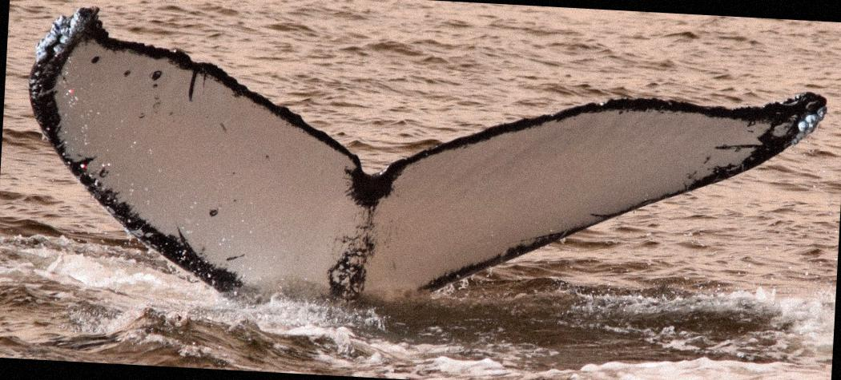
Dataset Augmentation
Gray
Rotation: up to 10°,
Random flip
GaussianNoise: scale up to 0.125*255
GaussianBlur: sigma up to 1.0
GammaContrast: gamma up to 1.5
Your Full Name, Your Title
Notes:
每张图都会随机取多个这里面提到的数据处理方法，随机生成小于10张的新图片

Slide 6
Menu
Objectives
Data Augmentation
PCB Model
Siamese Network
Future work
Whale Well

Slide 7
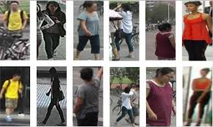
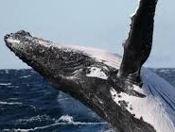
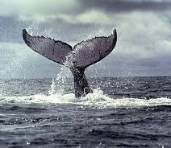
PCB Model
pedestrian
whale
view change
illumination change
Part of the body
few sample with label and more raw sample!
Whale Well

Slide 8
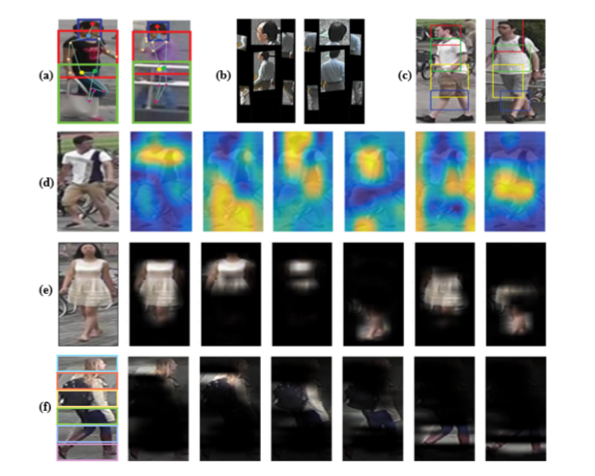
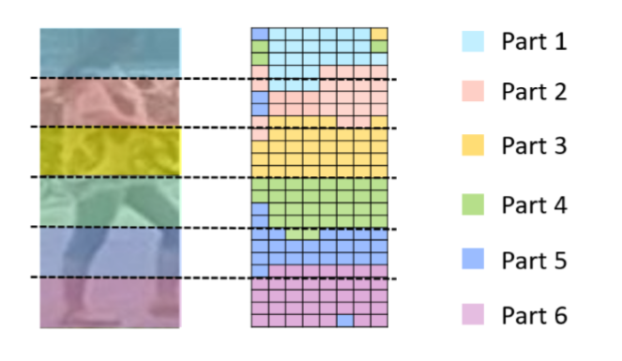
PCB Model
Sun, Y., Liang, Z., Yi, Y., Qi, T., & Wang, S. (2018). Beyond Part Models: Person Retrieval with Refined Part Pooling (and A Strong Convolutional Baseline). European Conference on Computer Vision.

Slide 9
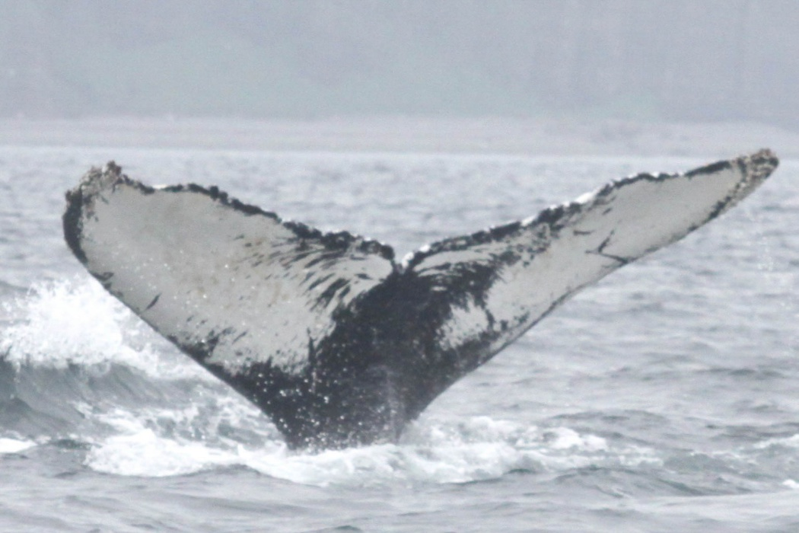
PCB Model
W
average pooling
convolution
two chunk
。。。
H
。。。
Input image
Convolution layers
From backbone network
Tensor T
Column vector
ID predictions
Resnet50 as backbone network

Slide 10
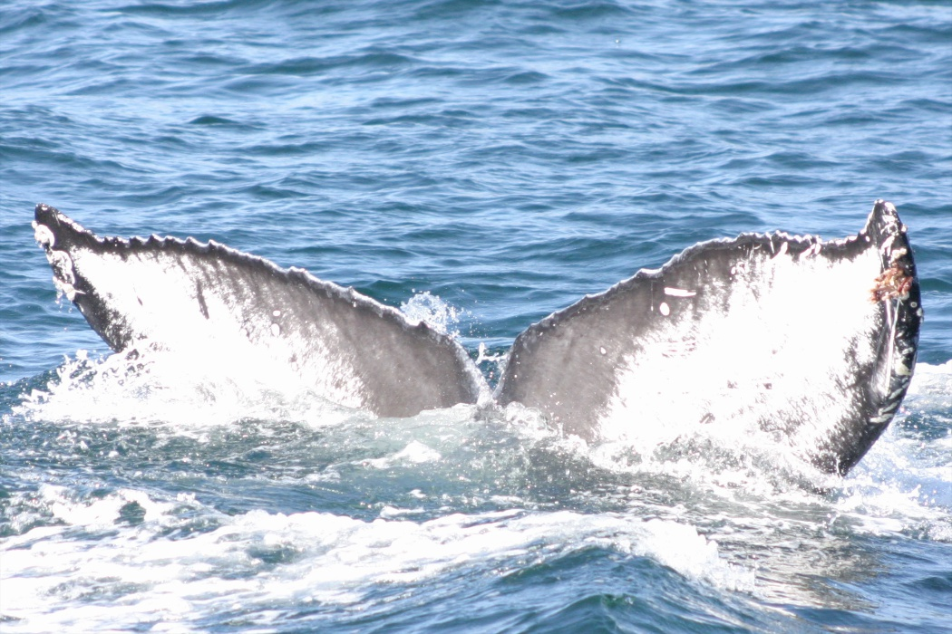
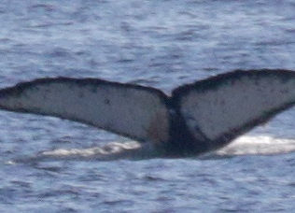
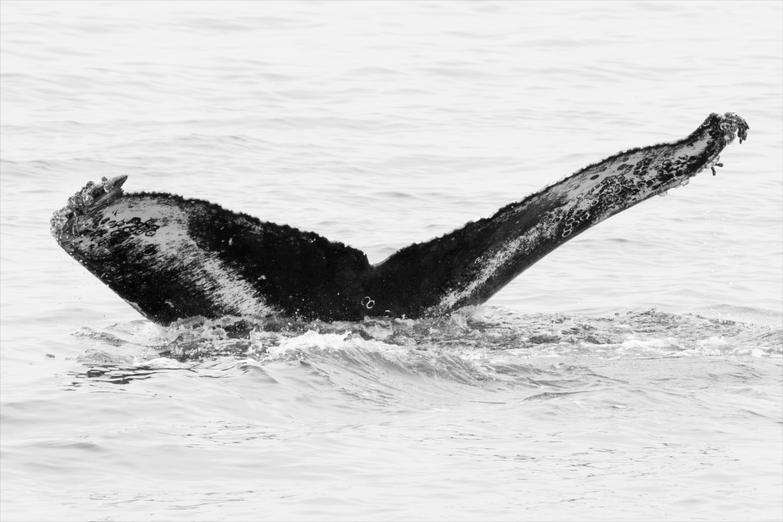
Query
Gallery
Metric distance
(European distance，Cosine distance )
。。。
。。。
。。。
。。。
。。。
No.1 | No.2 | No.3 | No.4 | No.5
Notes:
每张图都会随机取多个这里面提到的数据处理方法，随机生成小于10张的新图片

Slide 11
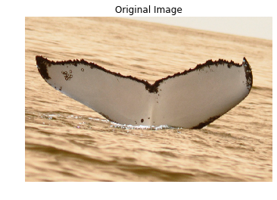

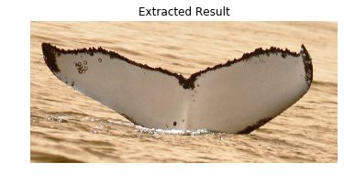
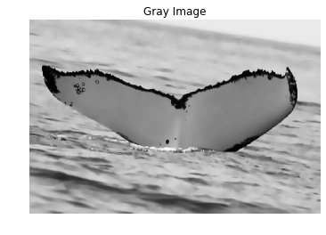
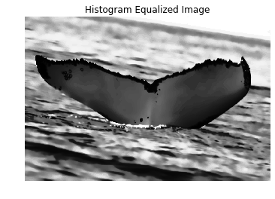
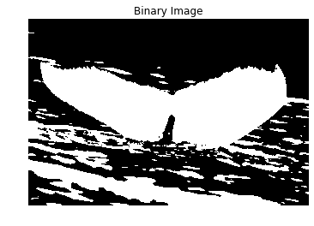
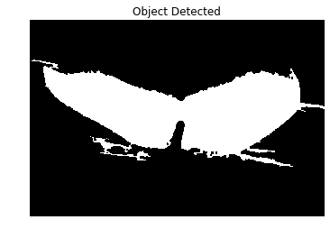
Object Detection -- Image processing pipeline
Image Filtering
Object Extraction
Histogram Equalization
Adaptive Threshold Segmentation
Connected-domain Detection

Slide 12
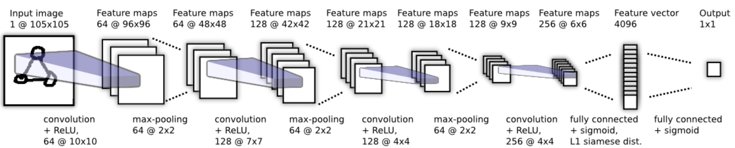
Siamese Network
Similarity measurements between samples
Suitable for small sample sets
94% accuracy on validation set
Koch, Gregory R.. “Siamese Neural Networks for One-Shot Image Recognition.” (2015).

Slide 13
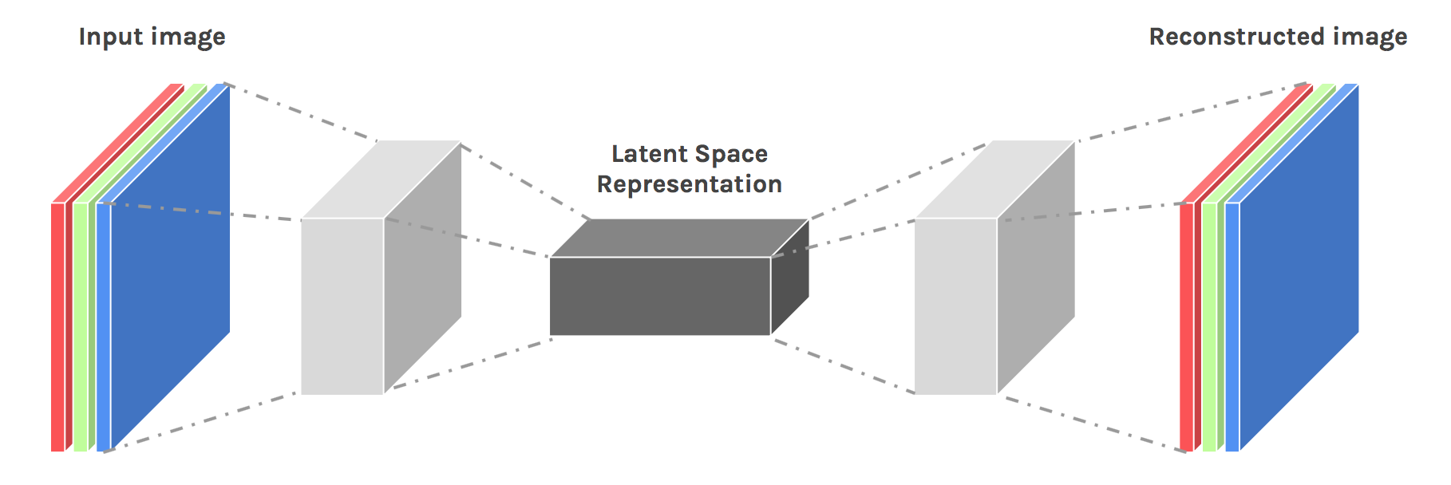
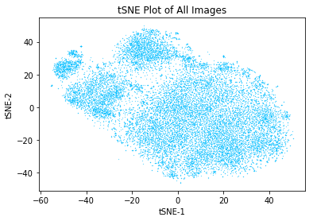
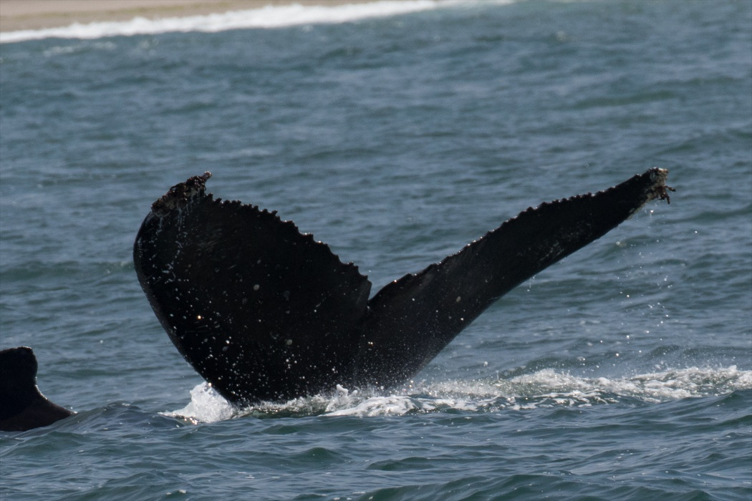
Compressed Feature Map & Clustering
Feature map
Clustering
https://becominghuman.ai/

Slide 14
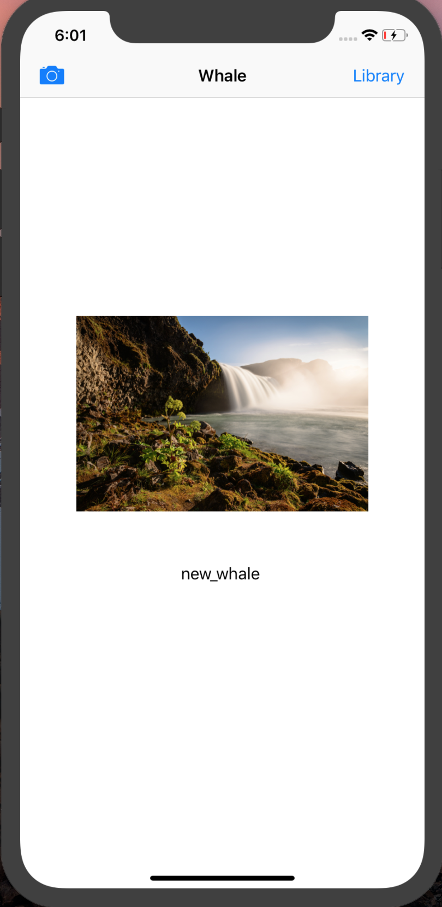
Future Work
Whale Well

Slide 15
Thank you!

Slide 16
Q & A

